Slide 1
What is cloud computing?

Slide 2
What is cloud computing, in simple terms?
How does cloud computing work?
What cloud computing services are available?

Slide 3
Examples of cloud computing
Gmail
cloud back-up of the photos on your smartphone
Netflix

Slide 4
Why is it called cloud computing?

Slide 5
What is the history of cloud computing?

Slide 6
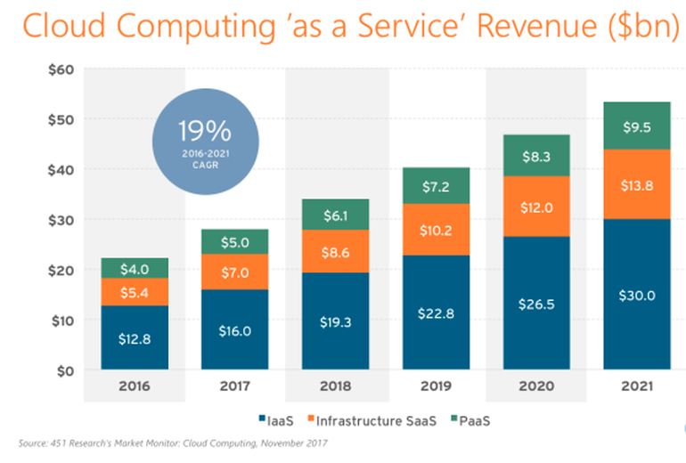
How important is the cloud?

Slide 7
3 types of cloud computing
There are three main service models of cloud computing
Infrastructure as a Service (IaaS),
Platform as a Service (PaaS)
Software as a Service (SaaS).

Slide 8
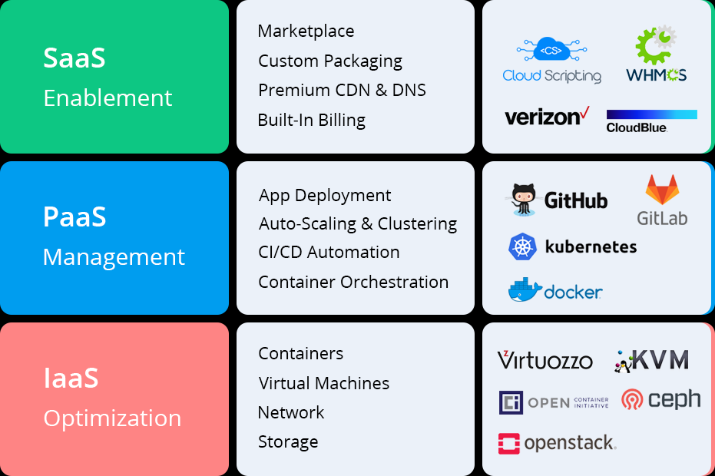
Infrastructure-as-a-Service
The fundamental building blocks of computing that can be rented:
physical or virtual servers
Storage
Networking

Slide 9
Platform-as-a-Service
tools and software that developers need to build applications
middleware, database management, operating systems, and development tools.

Slide 10
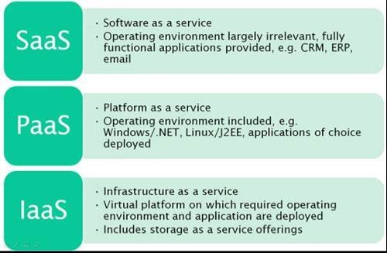
Software-as-a-Service
CRM
ERM

Slide 11
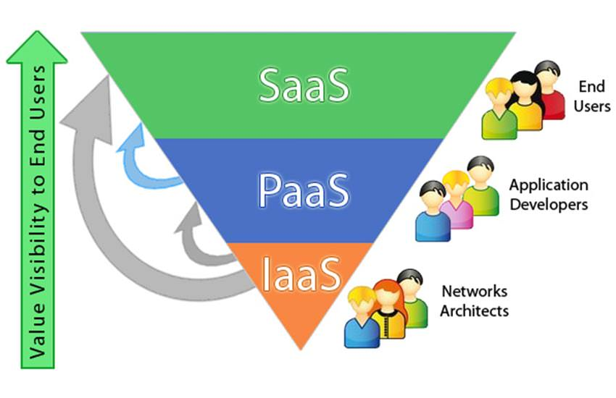

Slide 12
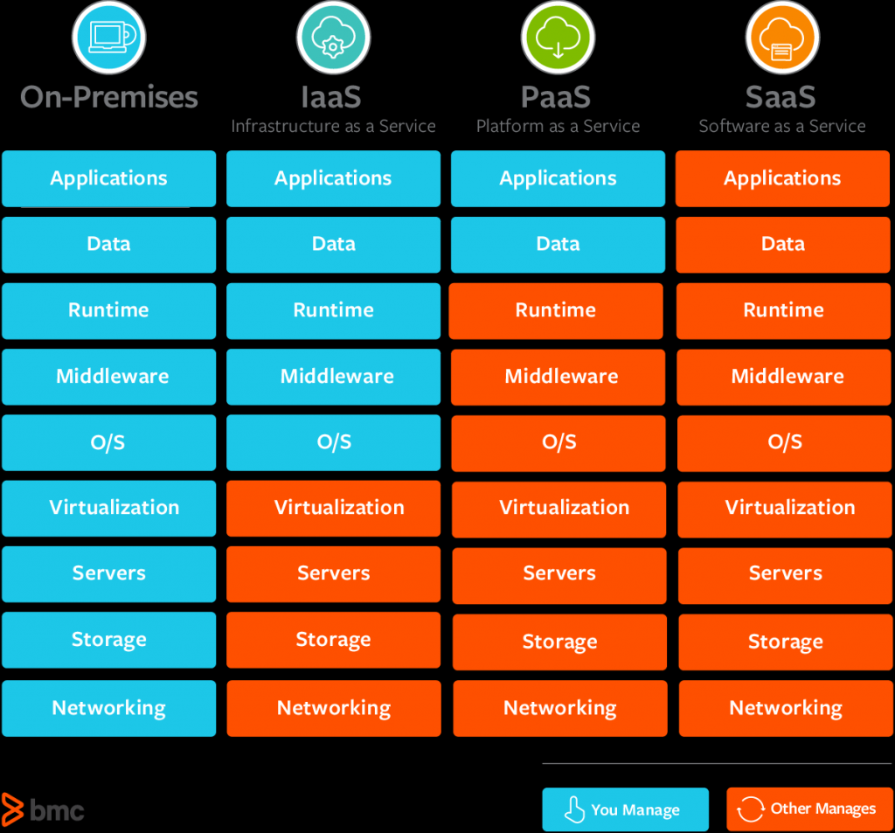

Slide 13
Cloud computing benefits
No more buying servers, updating applications or operating systems, or decommissioning and disposing of hardware or software when it is out of date,
companies can move faster on projects and test out concepts without lengthy procurement and big upfront costs

Slide 14
Advantages of Cloud computing
Reduced IT costs. Moving to cloud computing may reduce the cost of managing and maintaining your IT systems. ...
Scalability. ...
Business continuity. ...
Collaboration efficiency. ...
Flexibility of work practices. ...
Access to automatic updates.

Slide 15
Disadvantages of Cloud computing
Network Connection Dependency
Limited Features
Loss of Control
Security
Technical Issues

Slide 16
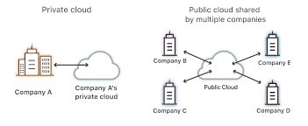
Public cloud
Public cloud is a cloud deployment model where computing resources are owned and operated by a provider and shared across multiple tenants via the Internet

Slide 17
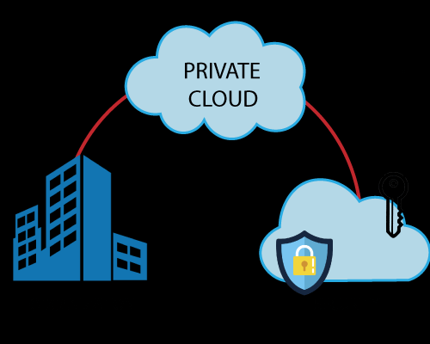
Private cloud
A virtual private cloud is an on-demand configurable pool of shared computing resources allocated within a public cloud environment, providing a certain level of isolation between the different organizations using the resources

Slide 18
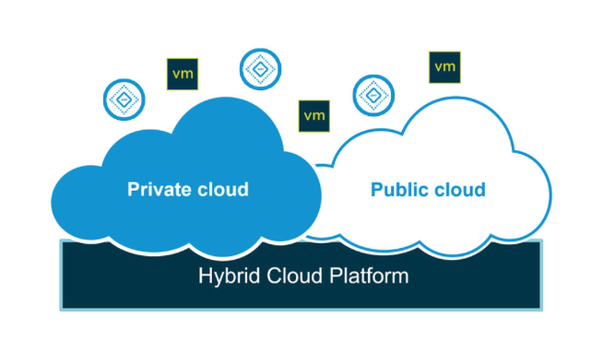
Hybrid cloud
Hybrid cloud is a cloud computing environment that uses a mix of on-premises, private cloud and third-party, public cloud services with orchestration between the two platforms.

Slide 19
Cloud service provider
A cloud service provider is a third-party company offering a cloud-based platform, infrastructure, application or storage services. Much like a homeowner would pay for a utility such as electricity or gas, companies typically have to pay only for the amount of cloud services they use, as business demands require.

Slide 20
Top cloud service providers
Microsoft Azure.
Amazon Web Services (AWS)
Google Cloud.
Alibaba Cloud.
IBM Cloud.
Oracle.
Salesforce.
SAP.

